Slide 1
Quale intervento in caso di GERD post-operatorio? « Altre tecniche»
PD Dr. med. habil. Sonja Chiappetta
Head of the Department of General and Laparoscopic Surgery
Center of Excellence Bariatric and Metabolic Surgery
Ospedale Evangelico Betania, Naples, Italy

Slide 2
Conflict of interest disclosure (COI)
I have the following potential conflict of interest to report
Receipt of honoraria or consultation fees:
Johnson & Johnson America (2021, 2024)
Novo Nordisc (2021)
Genesis Medtech (USA) (2023)

Slide 3
Case mix disclosure

Slide 4
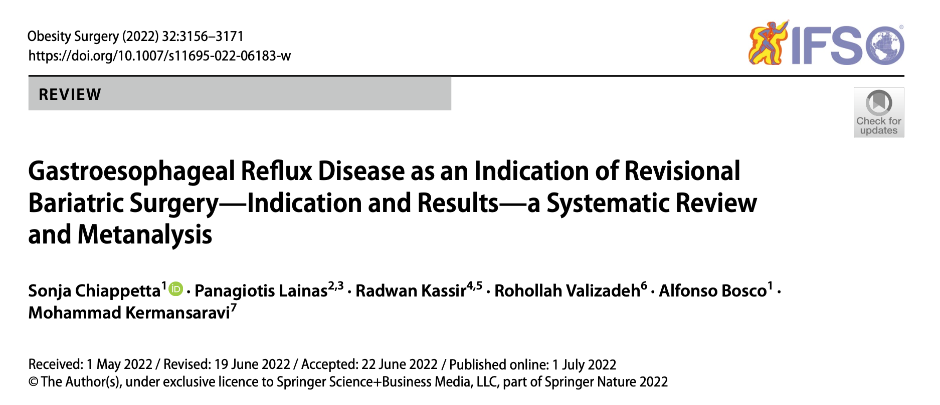
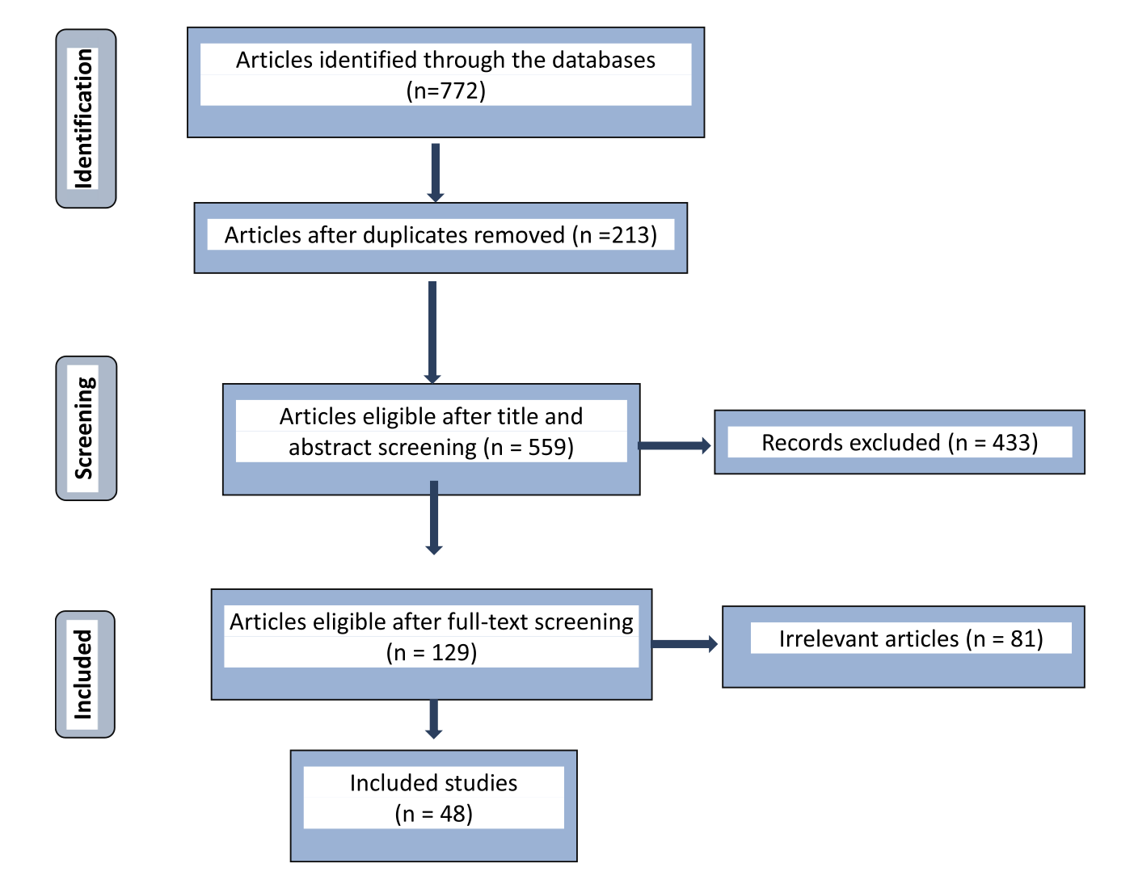
Postoperative GERD
articles published by April 1, 2021
“revisional bariatric surgery,” “RBS,” “conversion,” “gastric banding revision,” “sleeve gastrectomy, revision,” “gastric bypass revision,” “GERD,” “gas- troesophageal reflux disease,” “GERD after bariatric surgery,” “GERD after gastric banding,” “GERD after sleeve gastrectomy,” “GERD after gastric bypass,” “bile reflux,” “acid reflux,” “alkaline reflux,” “heart burn,” “dysphagia,” “esophagitis,” “erosive esophagitis,” “dys- pepsia,” “regurgitation,” “Barrett ́s esophagus,” “Barrett esophagus,” “hiatal hernia,” “sleeve stenosis,” “sleeve twist
n= 17437 patients
n = 915 RBS due to GERD

Slide 5
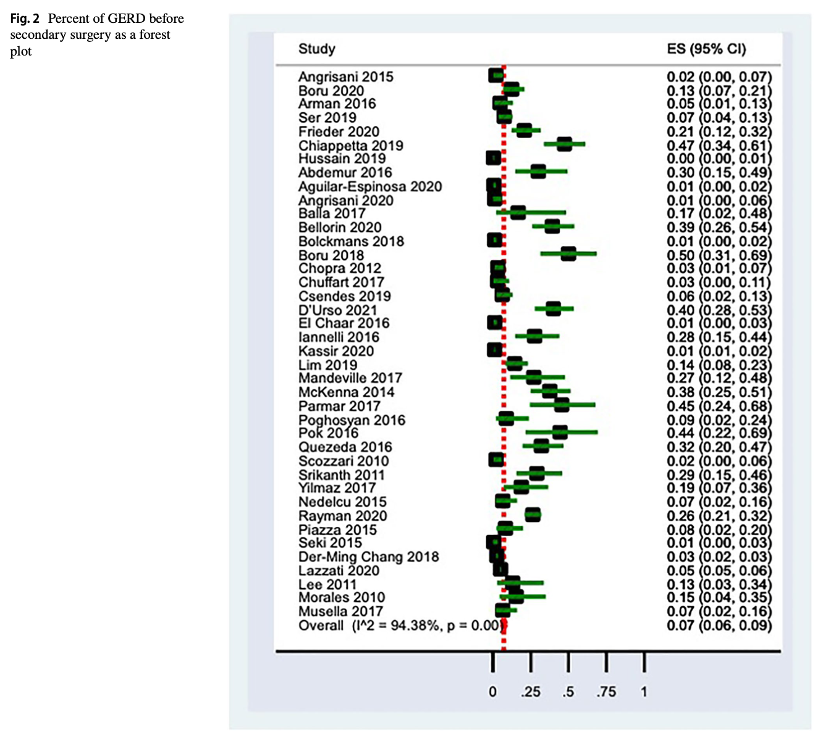
After primary BMS,
pooled estimation of a meta-analysis of studies reported a GERD of 7%

Slide 6
Postoperative GERD

Slide 7
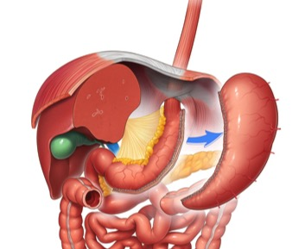
Reoperation following primary bariatric procedures
87%
6.8%
SG (27 studies, n = 764 patients, 83.5%) OAGB (8 studies, n = 62 patients, 6.8%)
SG with hiatal hernia repair (5 studies, n = 32 patients, 3.5%)
single anastomosis duodenal- jejunal bypass with sleeve gastrectomy (SADJB-SG) (1 study, n = 11 patients, 1.2%)
BPD/DS (1 study, n = 1 patient, 0.1%)
vertical banded gastroplasty (VBG) (2 studies n = 24 patients, 2.6%)
gastric banding (GB) (1 study, n = 4, 0.4%)
mixed data of RYGB and SG (n = 4, 0.4%), mixed data of GB and VBG (n = 11, 1.2%)
93.8%

Slide 8
Conversion in RYGB (32 studies, 310 patients)
Conversion in RYGB with hiatal hernia repair (7 studies, 80 patients)
→ Conversion in RYGB was the most performed RBS in this SR (390 of 533 patients, 73%)
Hiatal hernia repair with gastropexy (2 studies)
Braun Anastomosis (2 studies)
Re-SG (2 studies)
OAGB (2 studies)
Seromyotomy
secondary procedure was not named (n=4)
RBS for GERD included 7 different procedures:

Slide 9
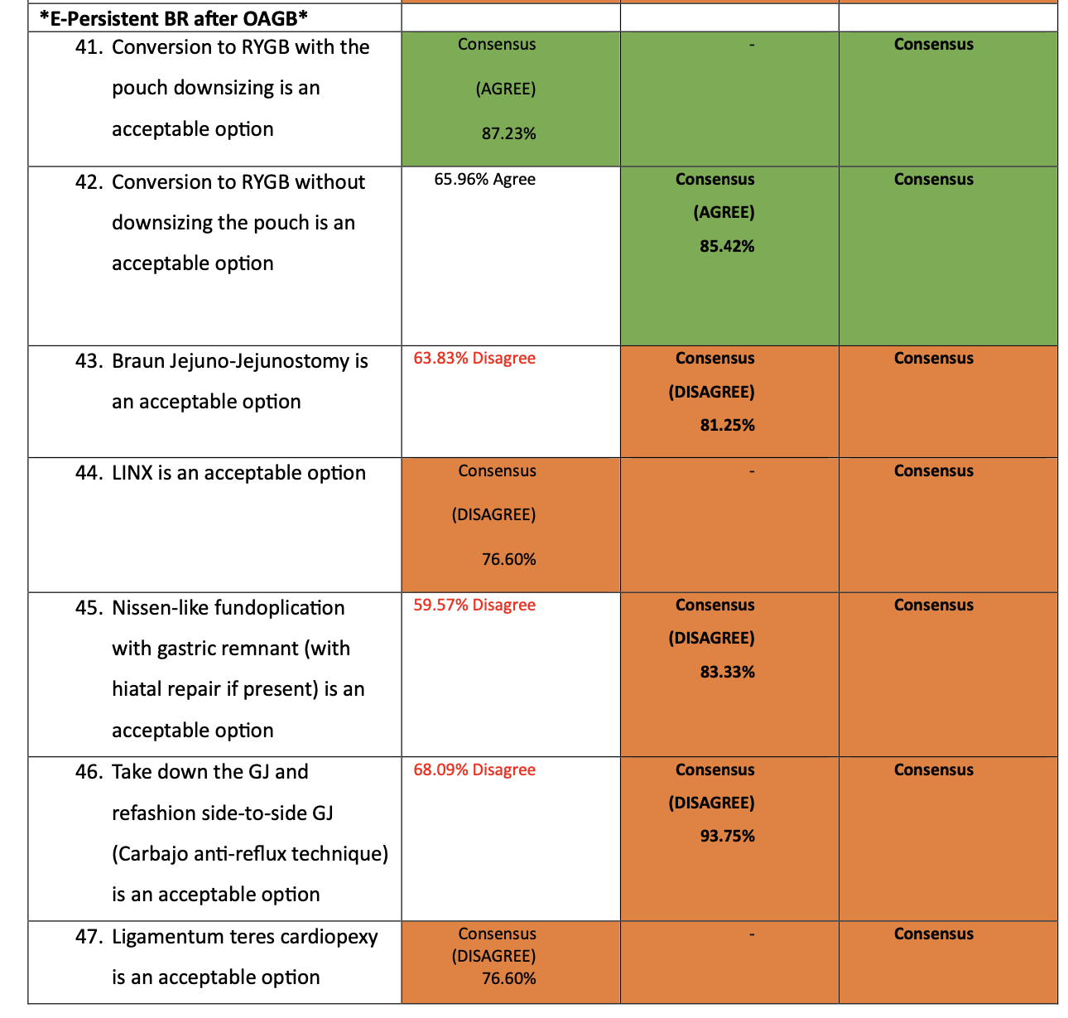
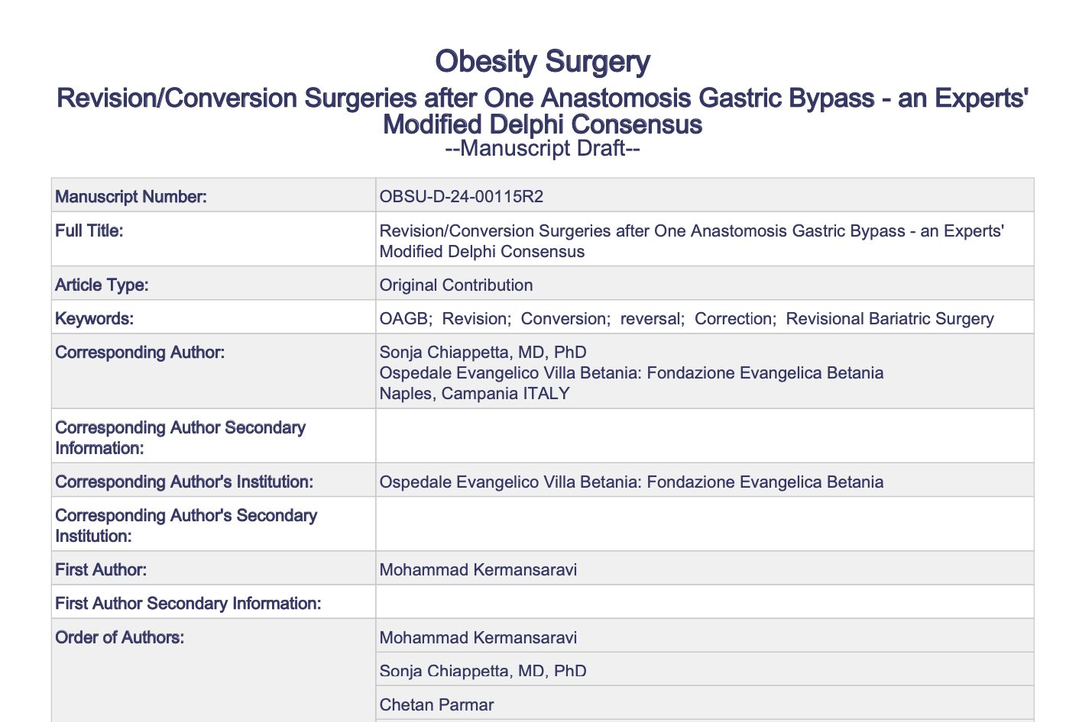
Bile Reflux after OAGB
R2 under review

Slide 10
Other techniques:
Re-Sleeve, hiatal hernia repair with gastropexy
Ligamentum teres hepatis
Magnetic sphincter Augmentation
SASI-S
OAGB
Seromyotomy

Slide 11
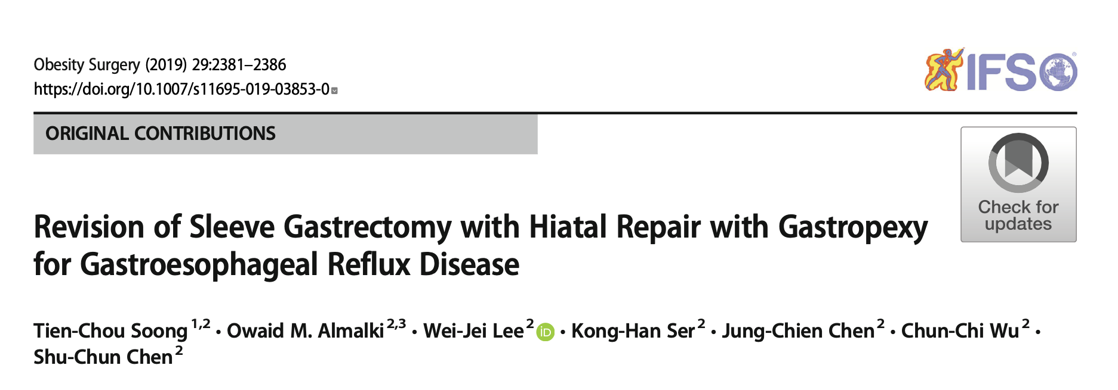
Re-Sleeve, hiatal hernia repair, gastropexy
28 patients

Slide 12
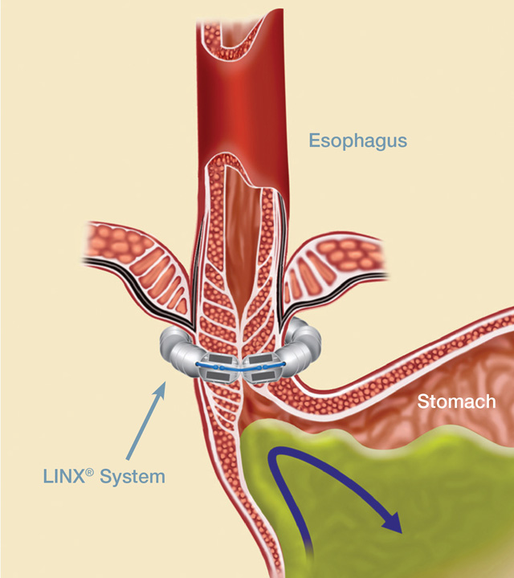
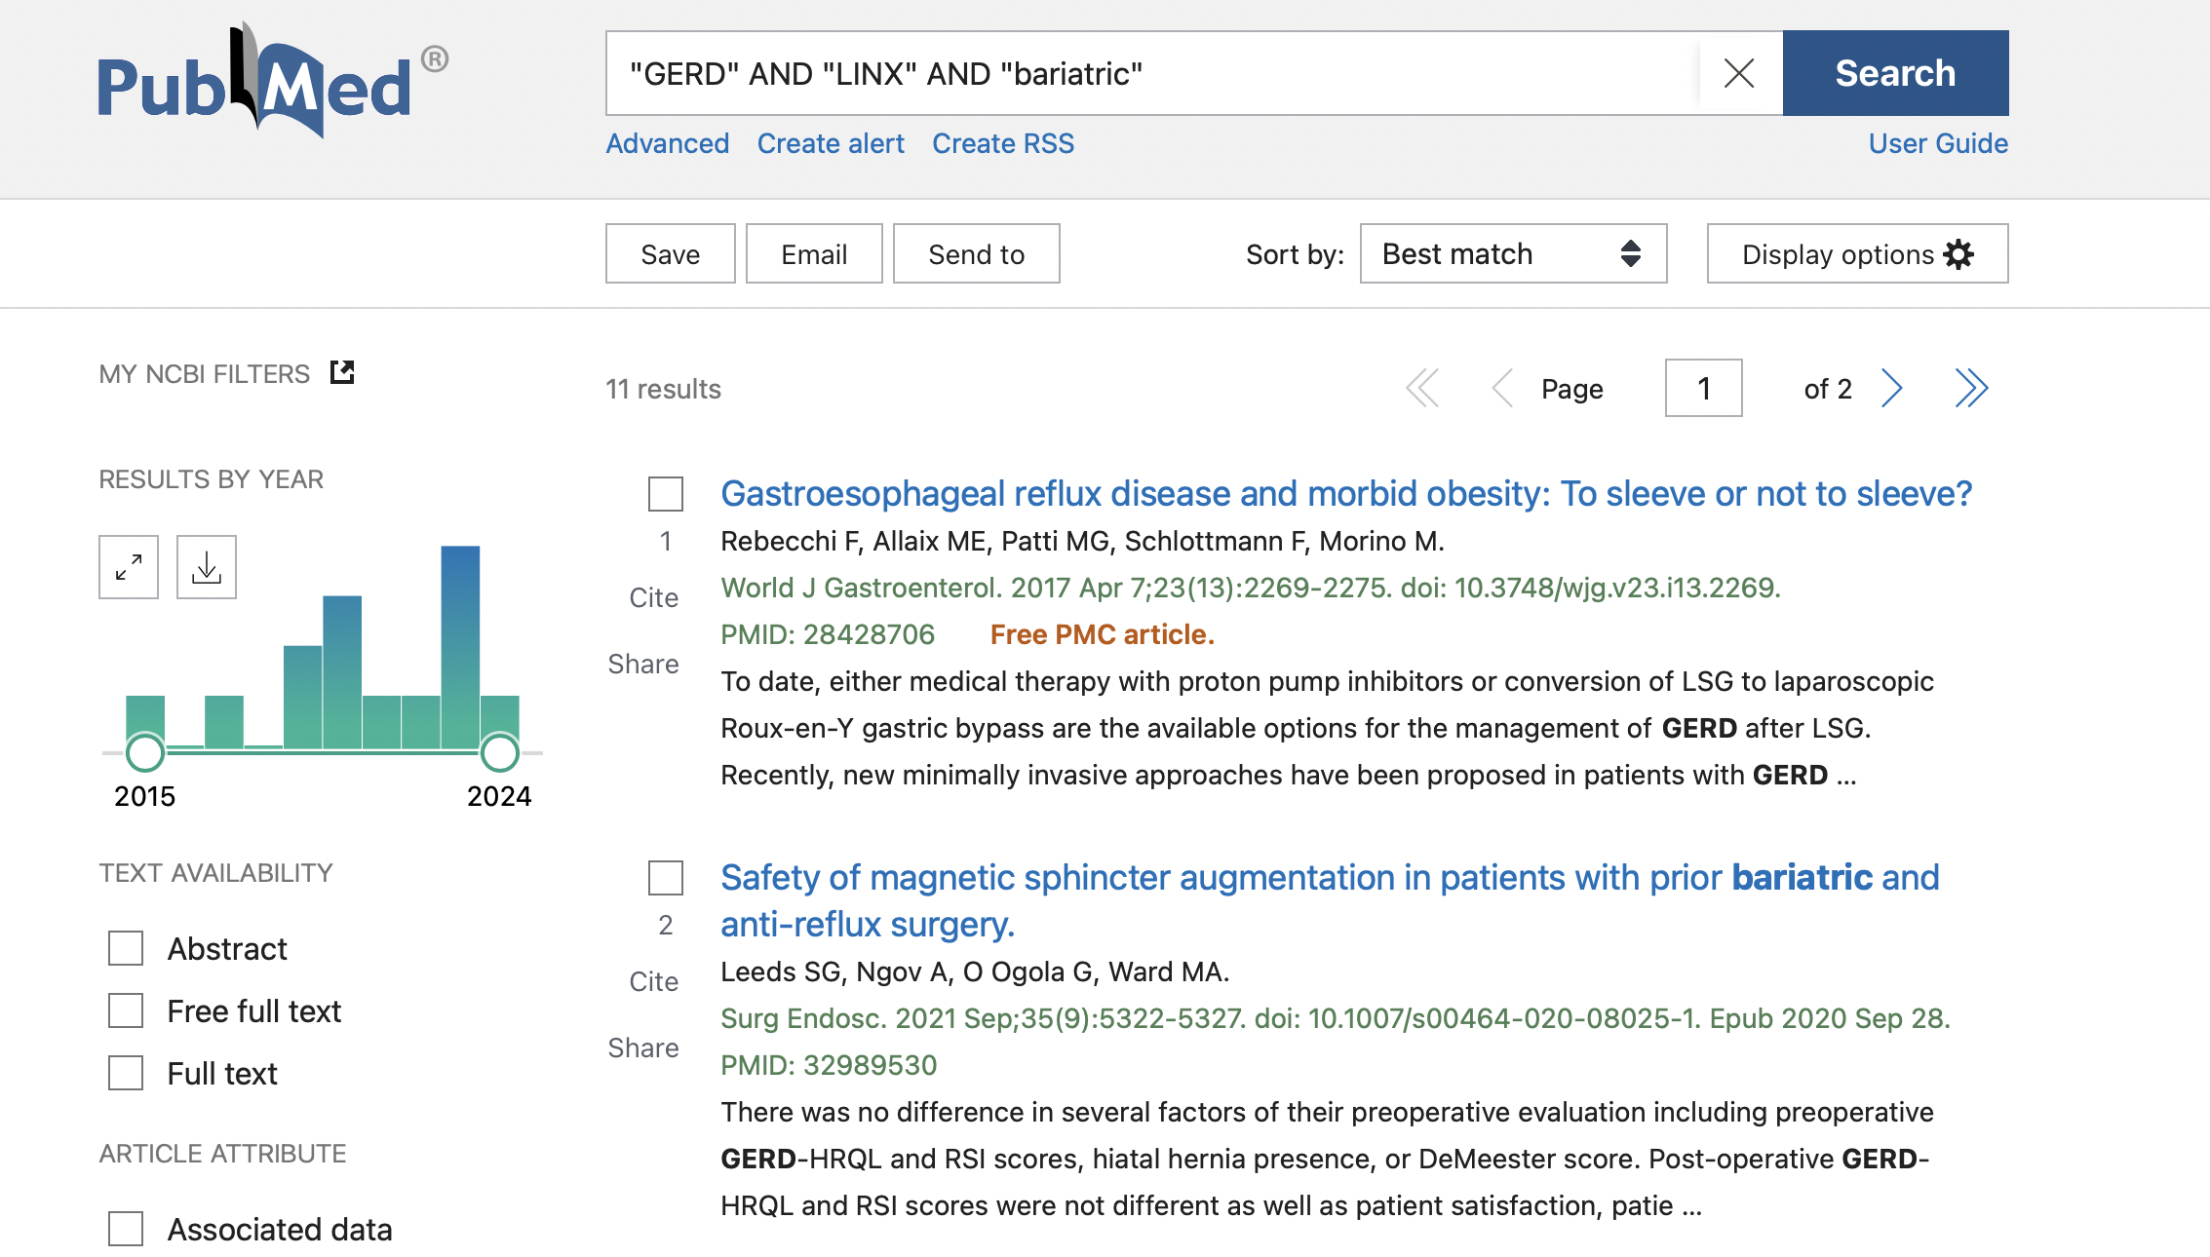
Magnetic Sphincter Augmentation
Dysphagia 6-83%
2.7-6.7% device removal /88% within the first 2 years

Slide 13
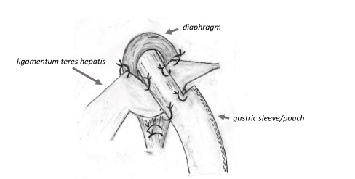
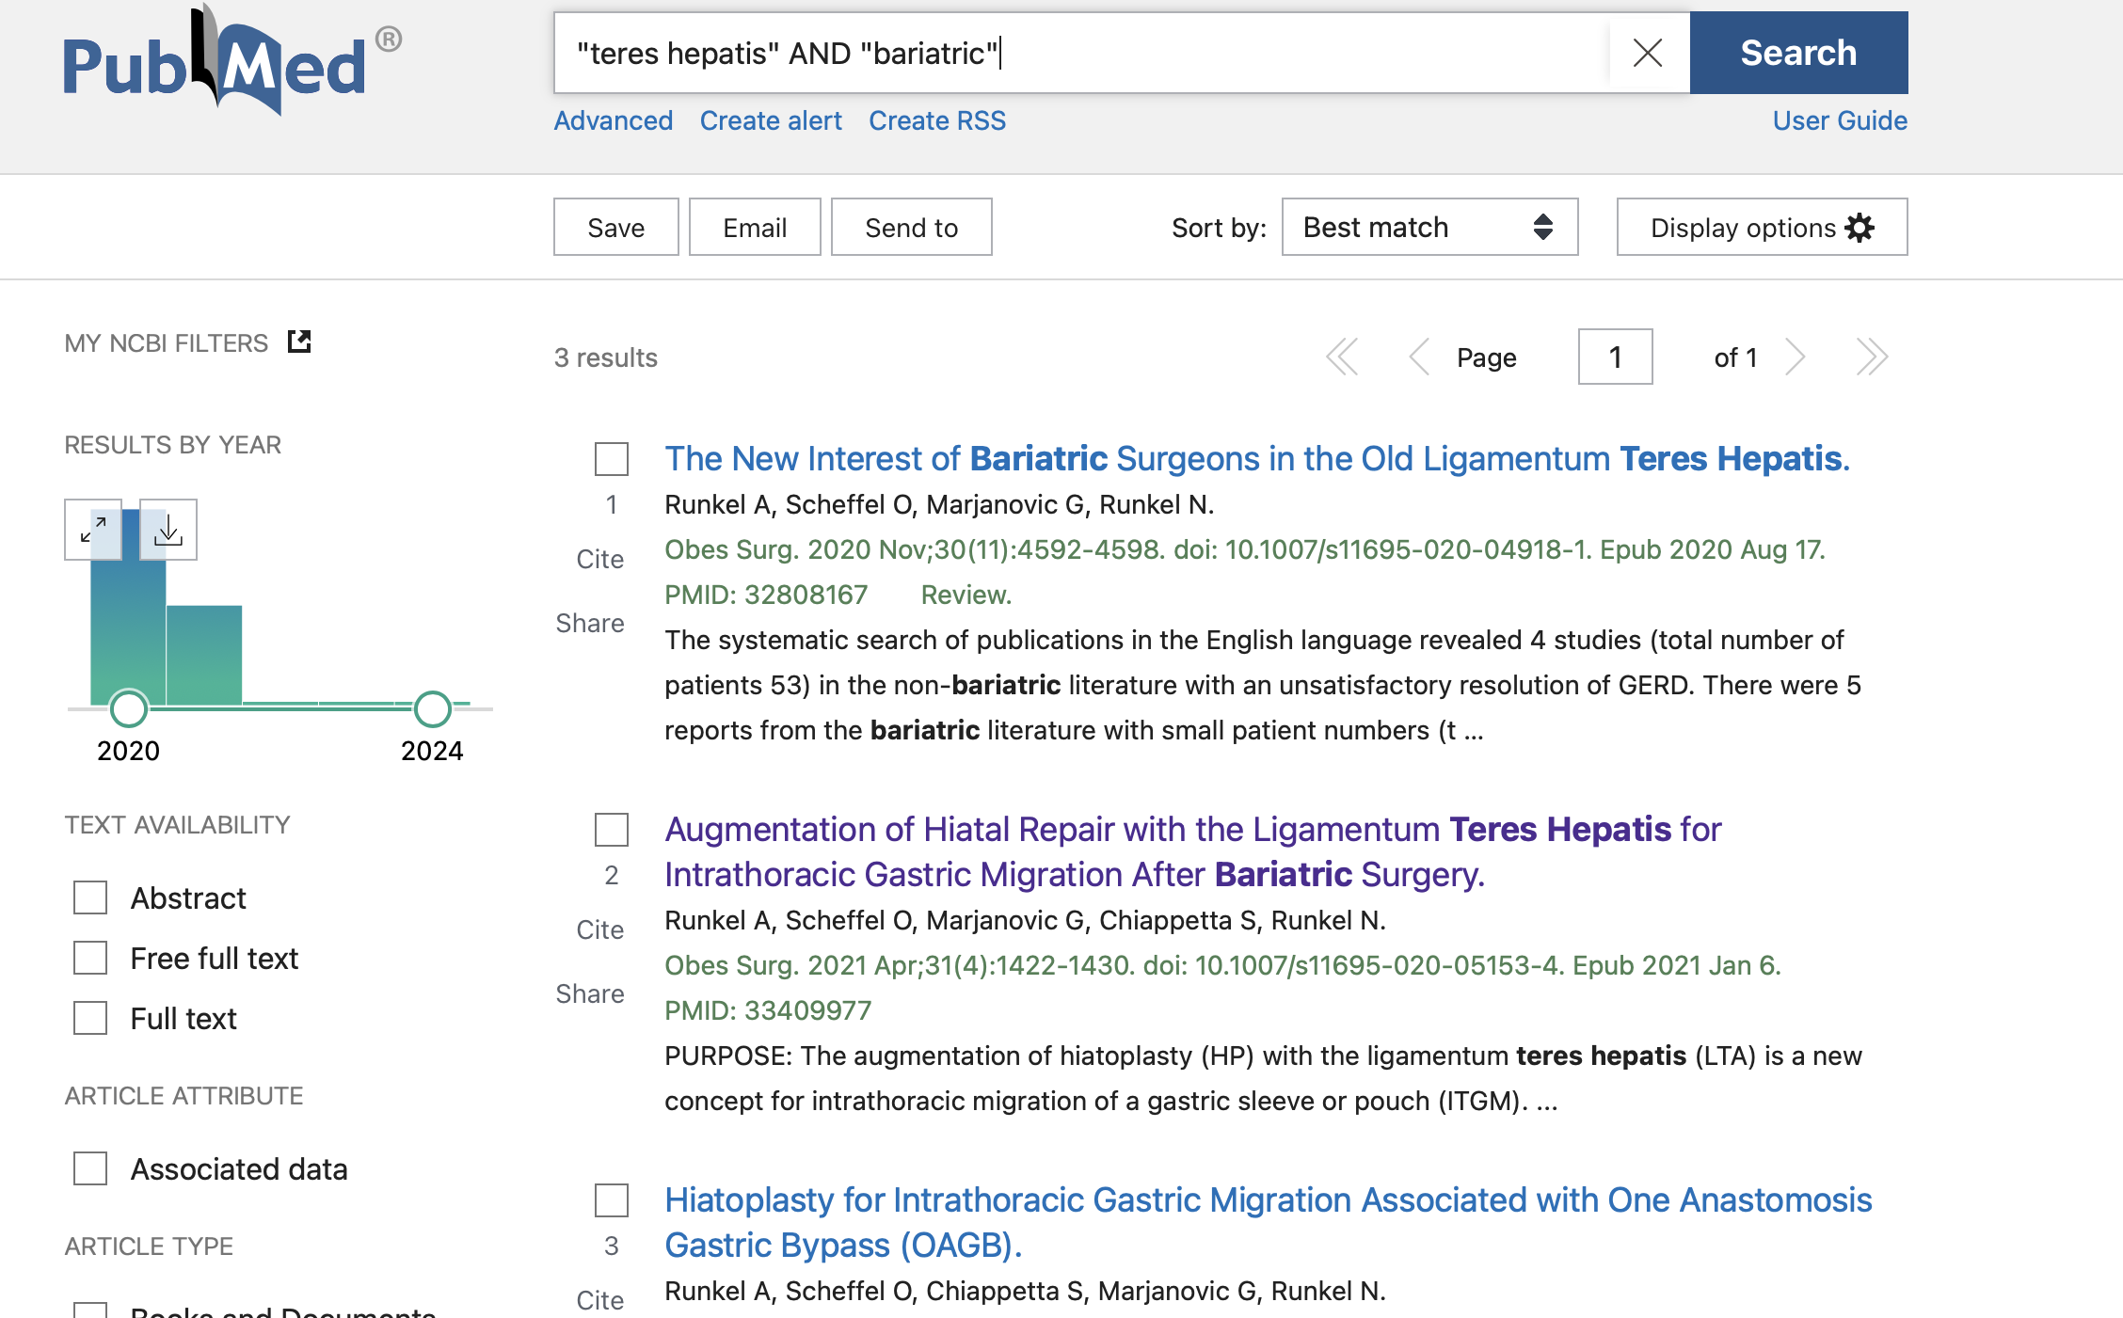
Lig. teres hepatis
Conclusions LTA reduces the risk of early ITGM recurrence. The long-term durability, however, needs to be further investigated.

Slide 14
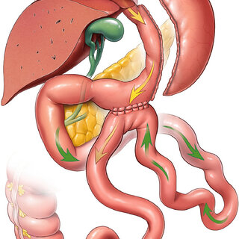
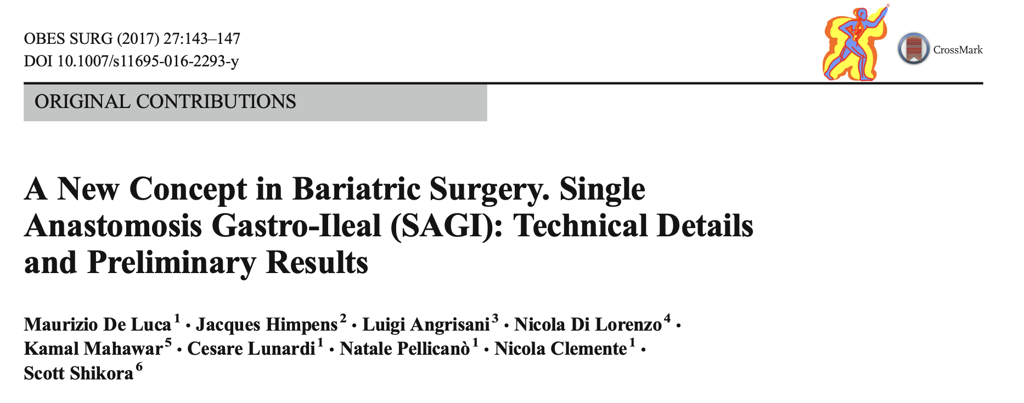
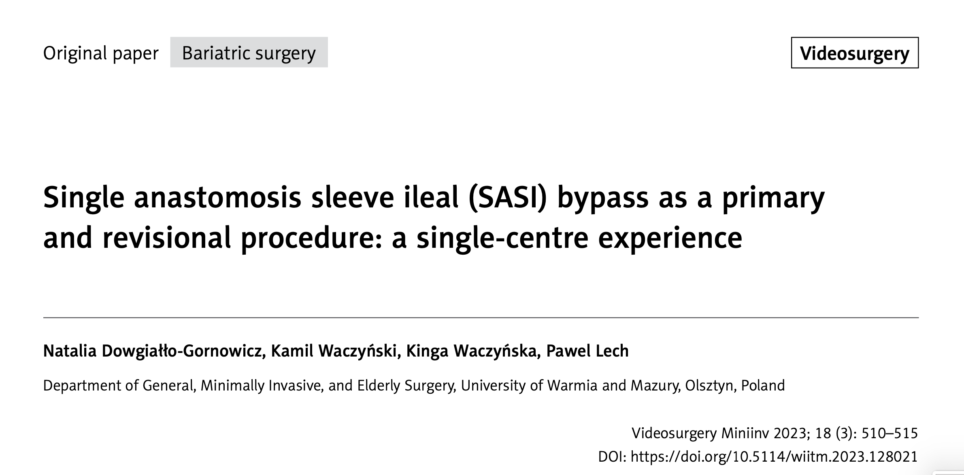
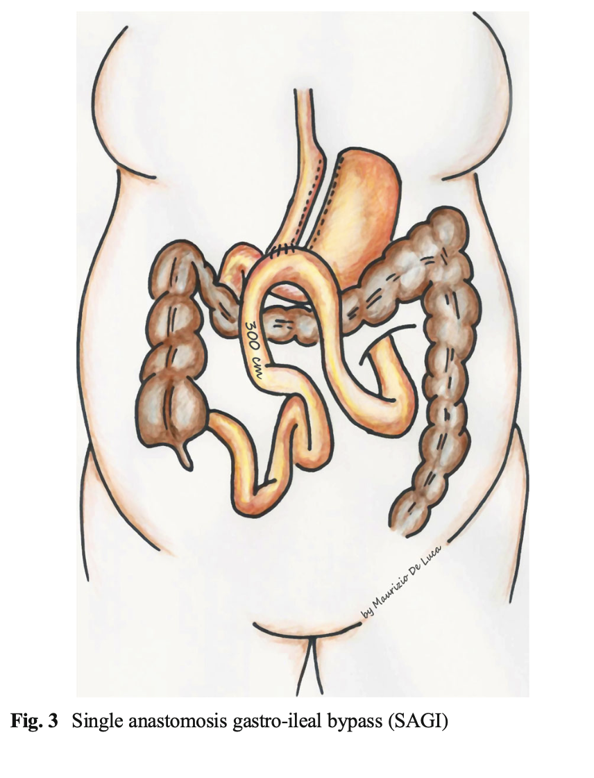
SASI (Single Anastomosis Sleeve Ileal Bypass)

Slide 15
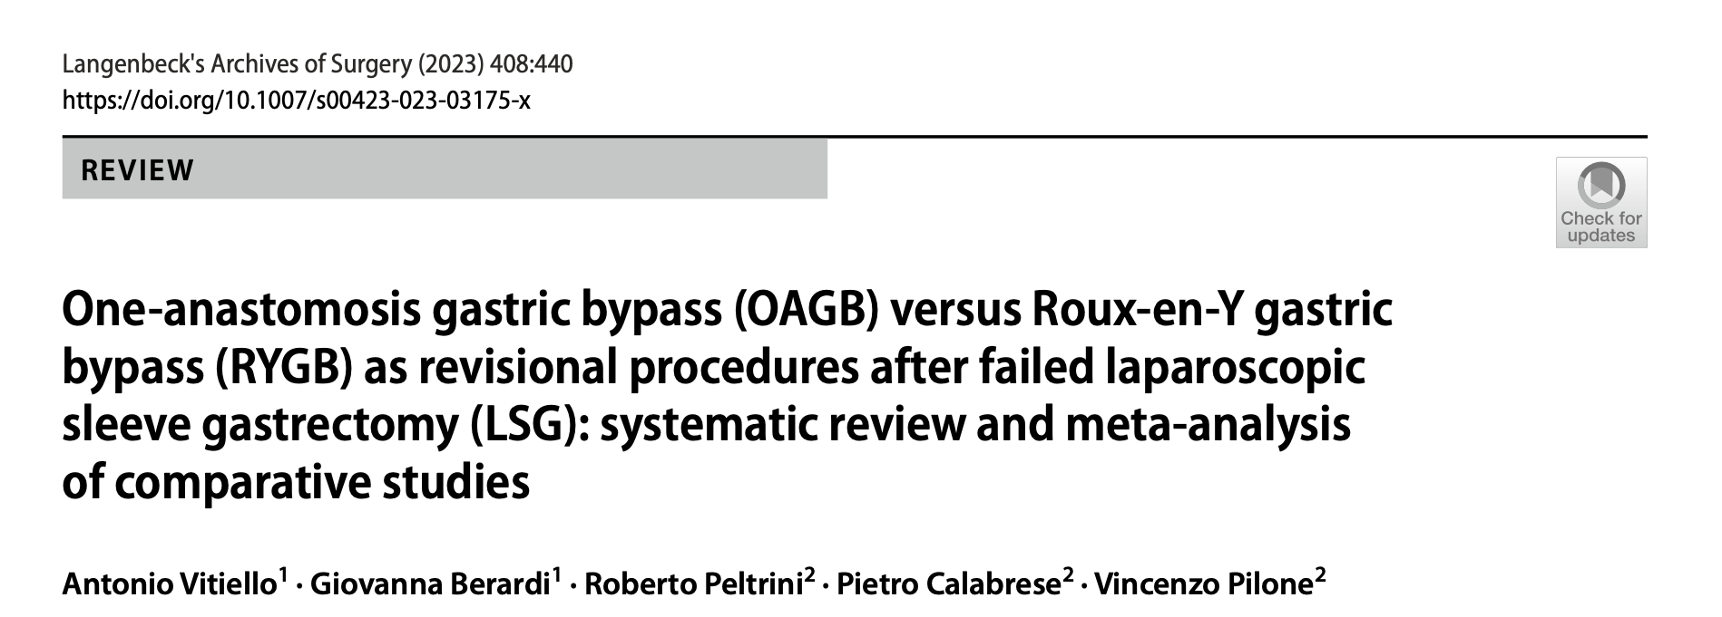
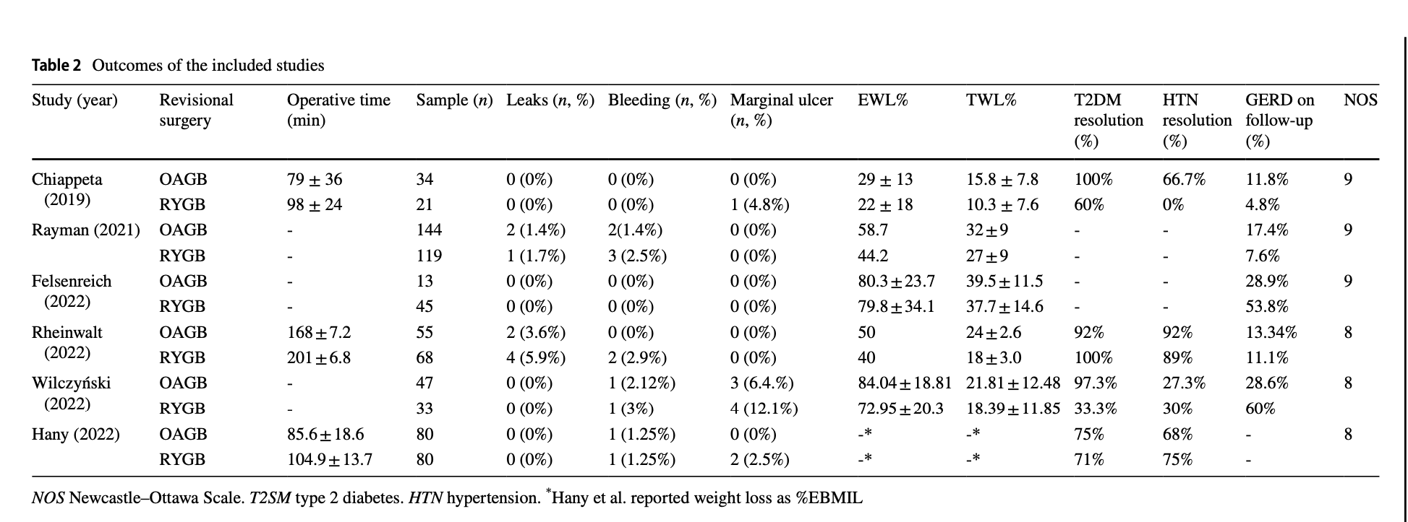
Sleeve in OAGB
In weight regain – convert to OAGB
In GERD – convert to RYGB
After conversion to OAGB, remission from GERD was 68.6% (81/118), and it was 80.6% (150/186) after conversion to RYGB with a RD = 0.10 (95% CI −0.04, 0.24), no statistical significance (p = 0.19), and high heterogeneity (I2= 96%).
De novo GERD was 6.3% (16/255) after conversional OAGB, and it was 0.5% (1/180) after conversion to RYGB with a RD = −0.23 (95% CI −0.57, 0.11), no statistical significance (p = 0.16), and high heterogeneity (I2= 92%).

Slide 16
Conclusions
Conversion to Roux-en Y Gastric Bypass is the only evidence-based revisional bariatric procedure in GERD after SG and AGB
Other techniques as:
Re-Sleeve, hiatal hernia repair, gastropexy, Lig. teres hepatis Augmentation, Magnetic Sphincter Augmentation, SASI …
→ are still investigative procedures

Slide 17
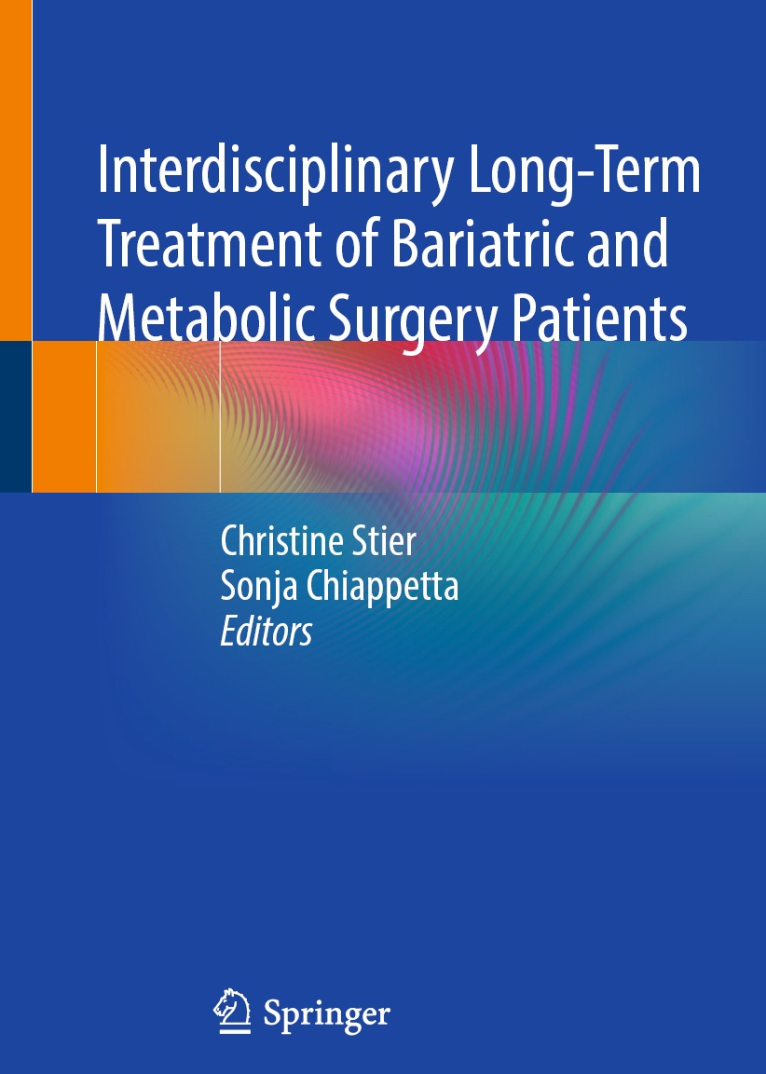
Grazie
drschiappetta@gmail.com
chiappetta.obesity.intouch
Sonja Chiappetta
PD Sonja Chiappetta

